Slide 1
Steganography-Based Secure Image Messaging System
CAPSTONE PROJECT
Presented By:
------------------------------------
P.V.Dinesh
Chaitanya Bharathi Institute of Technology
ECE Dept.

Slide 2
OUTLINE
Problem Statement
Technology used
Wow factor
End users
Result
Conclusion
Git-hub Link
Future scope

Slide 3

Problem Statement
Problem:
Insecure communication channels can lead to data breaches and privacy violations.
Traditional encryption methods are detectable and often targeted by hackers.
Solution:
Develop a steganography-based system to hide secret messages within images, ensuring secure and undetectable communication.

Slide 4

Technology used
Programming Language:
Python
Libraries:
OpenCV (cv2) for image processing.
OS and Subprocess for file handling and system operations.
Platform:
Cross-platform (Windows, macOS, Linux).

Slide 5

Wow factors
Unique Features:
Undetectable: Messages are hidden within image pixels, making them invisible to the naked eye.
Password Protection: Uses a password to encrypt and decrypt messages.
Cross-Platform: Works on Windows, macOS, and Linux.
User-Friendly: Simple command-line interface for easy usage.

Slide 6

End users
Target Audience:
Individuals and organizations needing secure communication.
Cybersecurity professionals.
Researchers and students studying steganography.

Slide 7
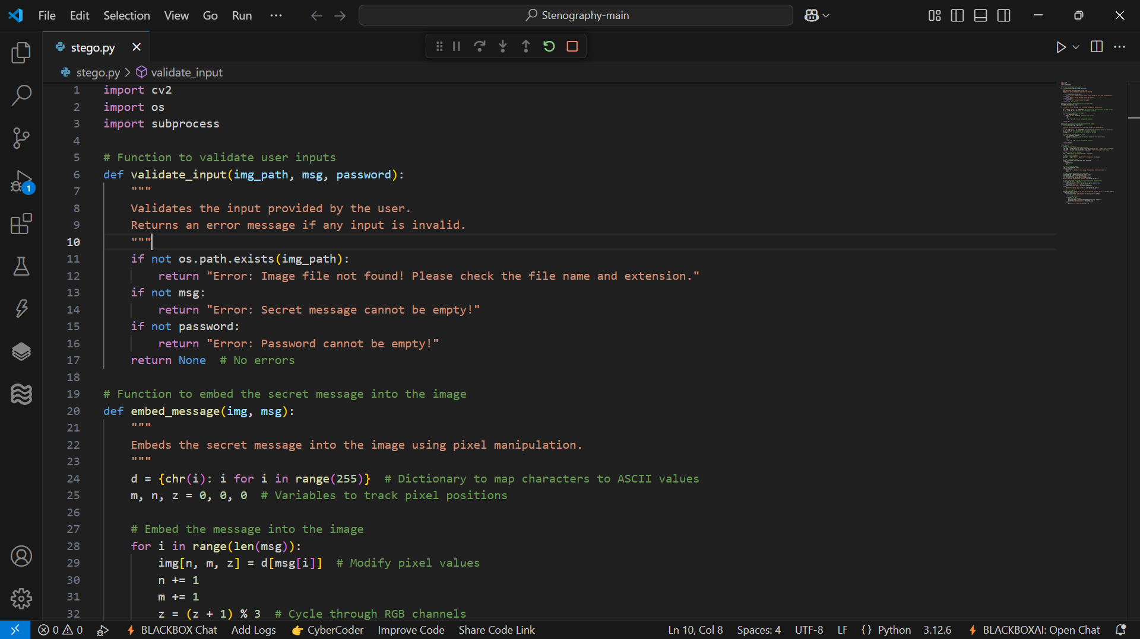
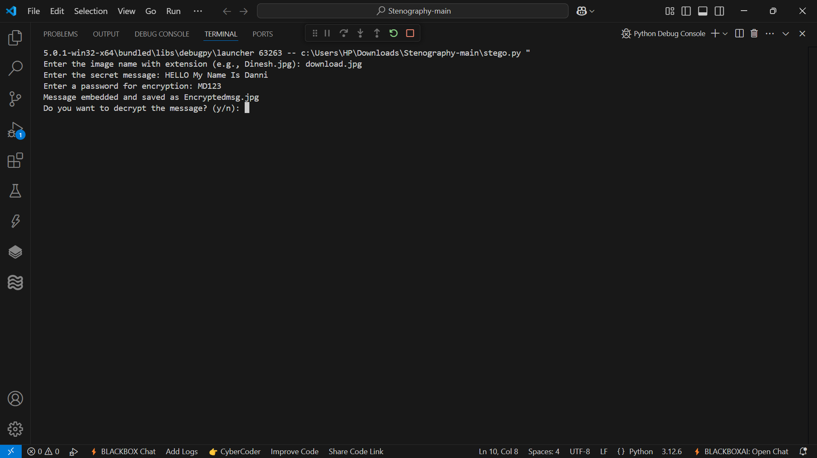
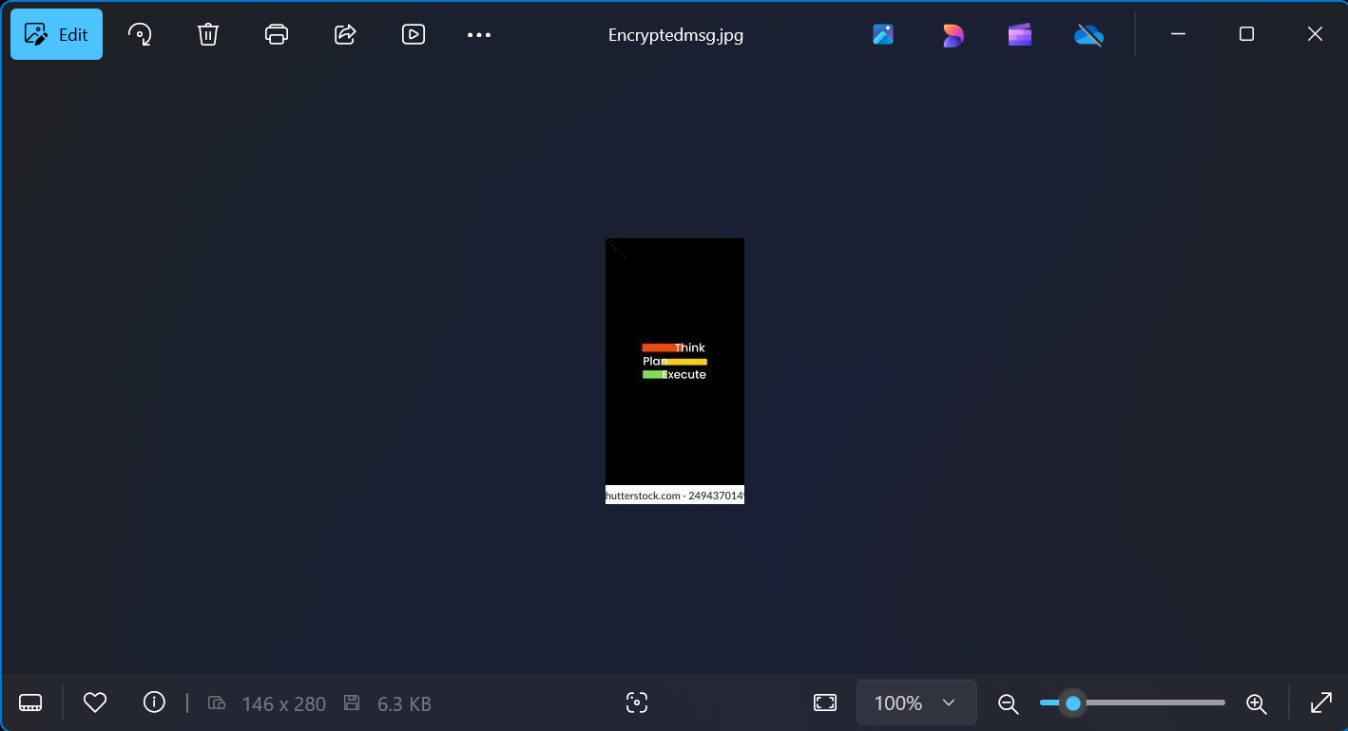
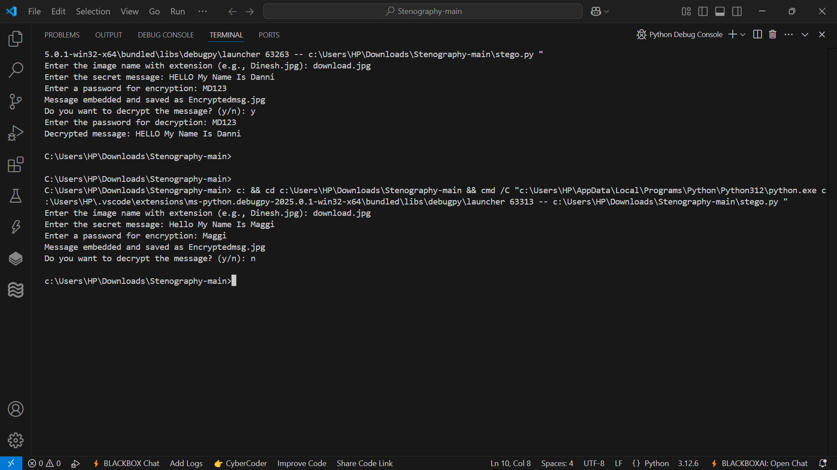
Results
Outcome:
Successfully embedded and extracted secret messages from images.
Password protection ensures only authorized users can decrypt the message.
Cross-platform compatibility tested and verified.
Screenshots: (AS GIVEN IN PICS)
Input image with a hidden message.
Encrypted image saved as Encryptedmsg.jpg
Decrypted message displayed in the terminal.

Slide 8

Conclusion
Summary:
Developed a secure and undetectable steganography-based
messaging system.
Achieved the goal of hiding messages within images using pixel manipulation.
Demonstrated the importance of secure communication in the digital age.

Slide 9

GitHub Link
GitHub Repository:
Link: https://github.com/Dharnishh/Steganography.git
Purpose:
Provides detailed instructions on how to use the project.
Explains the code and its functionality.
Target Audience:
Users who want to understand and use the steganography tool.
Developers interested in the code implementation.
.

Slide 10

Future scope
Enhancements:
Add a GUI for better user experience.
Implement advanced encryption algorithms
(e.g., AES) for stronger security.
Extend support for video and audio steganography.
Develop a web-based application for wider accessibility.

Slide 11
THANK YOU

